Slide 1
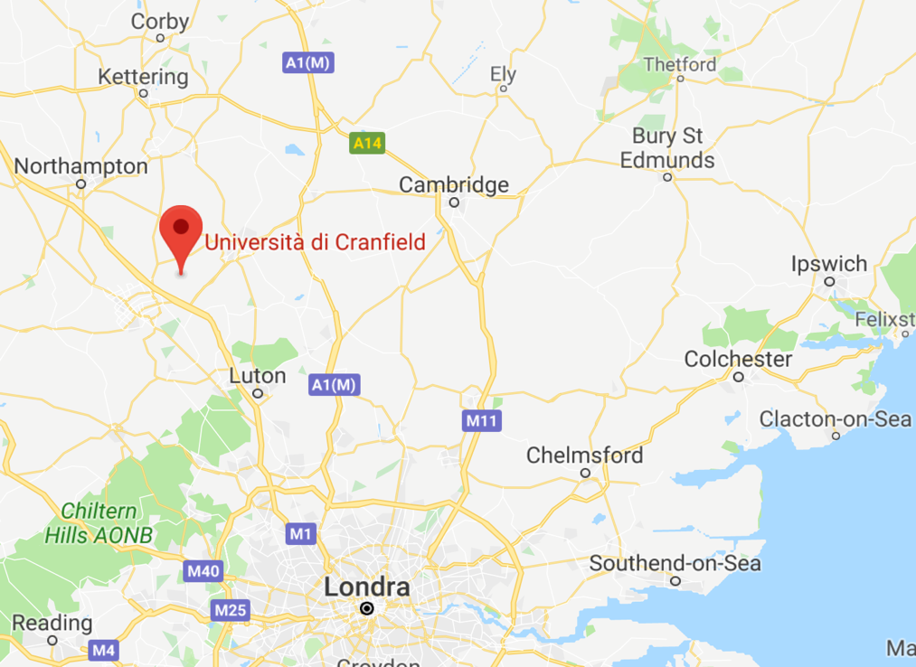
REFERENTE: Prof. Ilaria Giannoccaro

Slide 2
Structure
First year at PoliBa (60 ECTS)
Second year at Cranfield School of Engineering (60 ECTS)
Engineering and Management of Manufacturing Systems MSc
Management & Information Systems MSc

Slide 3
Engineering and Management of Manufacturing Systems MSc
 | ECTS
General Management | 3
Manufacturing Strategy | 3
Management of Technology and Innovation | 3
Manufacturing Systems Engineering | 3
Operations Analysis | 3
Enterprise Systems | 3
Operations Management | 3
Supply Chain Management | 3
Group Project | 12
Individual Thesis | 24

Slide 4
Management & Information Systems MSc
Enterprise Systems | 3
Operations Management | 3
Business Process Analysis and Engineering | 3
General Management | 3
Business Change Management | 3
Business Data Analytics | 3
Enterprise Modelling | 3
Programme and Project Management | 3
Group project | 12
Project Thesis | 24

Slide 5
Requirements
English score test
IELTS (International English Language Testing Service): Academic test - minimum overall score of 6.5
TOEFL (Test of English as a Foreign Language): Internet-based test - minimum score of 92. Our TOEFL institution code is 0822
Pearson Test of English (Academic): an overall score of 65
Cambridge English with a minimum score of 180
Trinity College London Integrated Skills in English III – Pass
Copy certificate as evidence of bachelor degree in Engineering
Two reccomendations letters

Slide 6
Fee and accomodations
Tuitions: £ 10250
Accomodations
https://www.cranfield.ac.uk/study/life-on-campus/life-at-cranfield/accommodation

Slide 7
Application and Contacts
Dr. Fan Ip-Shing, Cranfield University
Prof. Ilaria Giannoccaro, PoliBa
Application deadline
February

Slide 8
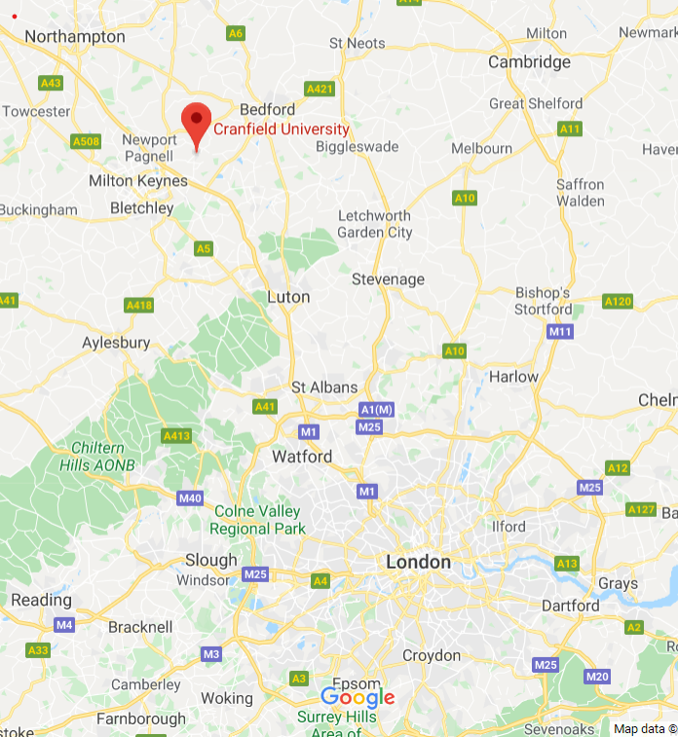

Slide 9
Cranfield is:
A postgraduate only science, technology, engineering and management university
A management school with strong industry links and a focus on applied learning
One of an elite group of schools worldwide to hold the triple accreditation
Experts in personal development
Cranfield’s masters programmes are designed for:
Self-motivated graduates who want a real world business education
Specialists who want to extend their skills set and knowledge
Open-minded individuals who are committed to self-improvement
Individuals that want to put knowledge into action

Slide 10
Structure
First year at PoliBa (60 ECTS)
Second year at Cranfield School of Management (60 ECTS)
Management MSc
https://www.cranfield.ac.uk/som/masters-courses/management
Logistics and Supply Chain Management MSc
https://www.cranfield.ac.uk/som/masters-courses/logistics-and-supply-chain-management#
Procurement and Supply Chain Management MSc
https://www.cranfield.ac.uk/som/masters-courses/procurement-and-supply-chain-management

Slide 11
Management MSc
Top-ranked management master's course
3rd in the UK and 30th in the world: The Economist Which MBA? Masters in Management (MiM) 2019 ranking
5th in the UK and 55th in the world: Financial Times Masters in Management 2018 ranking
6th in the UK and 28th in the world: QS World University Rankings: Management Masters Ranking 2020

Slide 12
Management MSc Programme
 | Credits | ECTS
10 COMPULSORY | 100 | 30
Marketing Management | 10 | 3
Organisational Behaviour: Application | 10 | 3
Accounting and Finance | 10 | 3
People Management and Leadership | 10 | 3
Economics for Managers | 10 | 3
Managing Operations | 10 | 3
Strategic Management | 10 | 3
Management Consulting | 10 | 3
Leading Corporate Sustainability | 10 | 3
Evidence-Based Management | 10 | 3
3 ELECTIVES | 30 | 9
Organisational Performance: Direction Control and Measurement | 10 | 3
Supply Chain Management | 10 | 3
Disruptive Innovation | 10 | 3
Entrepreneurship | 10 | 3
Mastering Project Management | 10 | 3
Effective Cross-Cultural Management | 10 | 3
MASTER THESIS | 90 | 27
TOT | 220 | 66
27 = 18 Tesi + 6 tiroc + 3 Sovr

Slide 13
Logistics & SCM MSc Programme
 | Credits | ECTS
10 COMPULSORY | 100 | 30
Freight Transport | 10 | 3
Inventory and Operations Management | 10 | 3
Information Systems and e-Business | 10 | 3
Project Management Introduction | 10 | 3
Physical Network Design | 10 | 3
Warehousing | 10 | 3
Business Process Outsourcing | 10 | 3
Designing and Managing Resilient Supply Chains | 10 | 3
Logistics Outsourcing | 10 | 3
Planning and Resourcing Road Freight Transport | 10 | 3
4 ELECTIVES | 20 | 6
Humanitarian Logistics | 5 | 1.5
Simulation | 5 | 1.5
Six Sigma | 5 | 1.5
Performance Measurement in the Supply Chain | 5 | 1.5
Sales and Operations Planning | 5 | 1.5
Retail Logistics | 5 | 1.5
Social Network Analysis in a Supply Chain Context | 5 | 1.5
Business Model Generation | 5 | 1.5
Future of Digital Procurement | 5 | 1.5
Big Data Analytics for Supply Chain Management | 5 | 1.5
Circular Supply Chains | 5 | 1.5
MASTER THESIS | 80 | 24
TOT | 200 | 60

Slide 14
Procurement & SCM MSc Programme
 | Credits | ECTS
10 COMPULSORY | 100 | 30
Principles of Strategic Procurement | 10 | 3
Supply Chain Strategy and Sustainability | 10 | 3
Accounting and Finance | 10 | 3
Analytical Techniques for Supply Chain Management | 10 | 3
Freight Transport | 10 | 3
Inventory and Operations Management | 10 | 3
Information Systems and e-Business | 10 | 3
Project Management Introduction | 10 | 3
Supplier Selection and Evaluation | 10 | 3
Negotiation and Contract Management | 10 | 3
4 ELECTIVES | 20 | 6
Business Process Outsourcing | 5 | 1.5
Designing and Managing Resilient Supply Chains | 5 | 1.5
Logistics Outsourcing | 5 | 1.5
Planning and Resourcing Road Freight Transport | 5 | 1.5
Humanitarian Logistics | 5 | 1.5
Simulation | 5 | 1.5
Six Sigma | 5 | 1.5
Performance Measurement in the Supply Chain | 5 | 1.5
Sales and Operations Planning | 5 | 1.5
Retail Logistics | 5 | 1.5
Social Network Analysis in a Supply Chain Context | 5 | 1.5
Business Model Generation | 5 | 1.5
Future of Digital Procurement | 5 | 1.5
Big Data Analytics for Supply Chain Management | 5 | 1.5
Circular Supply Chains | 5 | 1.5
MASTER THESIS | 80 | 24
TOT | 200 | 60

Slide 15
MSc Entry Requirements
English score test
IELTS (International English Language Testing Service): Academic test - minimum overall score of 6.5 (NB: 7.0 for MSc Management)
TOEFL (Test of English as a Foreign Language): Internet-based test - minimum score of 92. Our TOEFL institution code is 0822
Pearson Test of English (Academic): an overall score of 65
Cambridge English with a minimum score of 180
Trinity College London Integrated Skills in English III – Pass
Copy certificate as evidence of bachelor degree in Engineering
Two recommendation letters

Slide 16
MSc Tuition Fees (2020/21)
Cranfield Tuition Fees (*with PoliBa 25% double degree discount) | UK/EU* | Overseas*
MSc Management | £11,250 | £19,500
MSc Logistics & SCM | £9,750 | £18,375
MSc Procurement & SCM | £9,750 | £18,375

